Slide 1

Weather Forecasting
Mini Project Phase 1- EDA and DPL
Rudraksh Kavishwar 23070126511
Saee Hudli 23070126512

Slide 2
Problem Statement
What is Weather Forecasting?
A weather forecast is simply a scientific estimate of future weather condition.
Weather condition is the state of the atmosphere at a given time expressed in terms of the most significant weather variables.
The significant weather variables being forecast differ from place to place.

Slide 3
Objectives
EDA
DPL
Understand the Structure of the Data
Identify Patterns and Trends
Detect Anomalies and Outliers
Formulate Hypotheses
Data Cleaning and Preprocessing
Data Collection and Preprocessing
Prediction Accuracy
Timeliness
Integration of Multiple Data Sources
User-Friendly Outputs

Slide 4
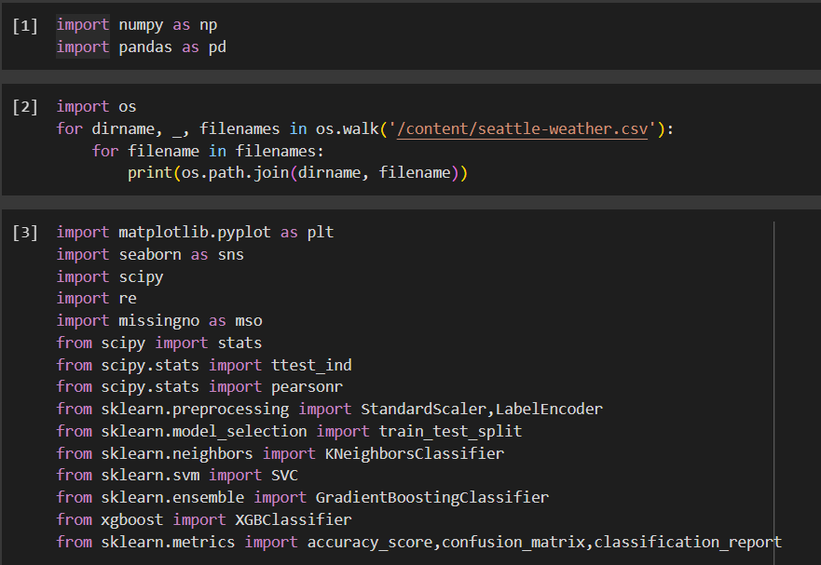
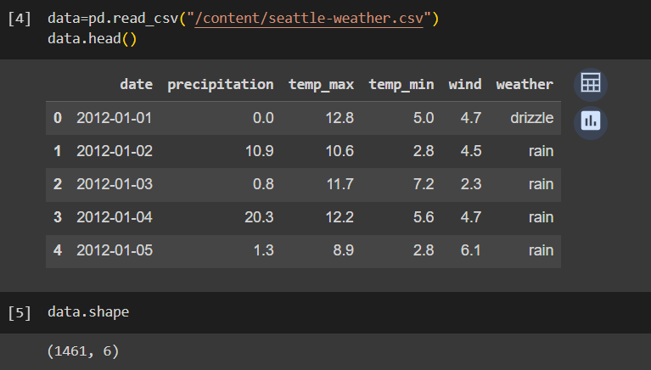
Data Acquisition Obtained by Web Scraping

Slide 5
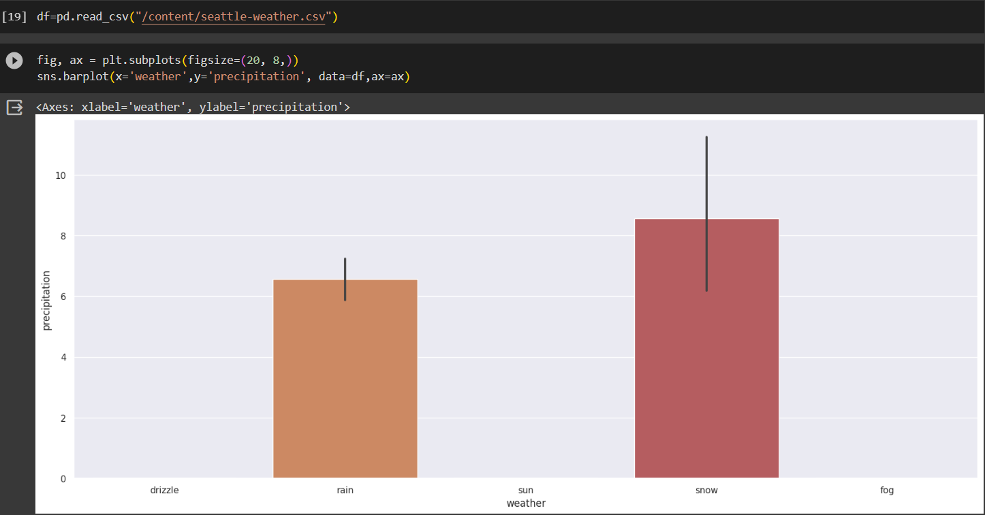

Slide 6
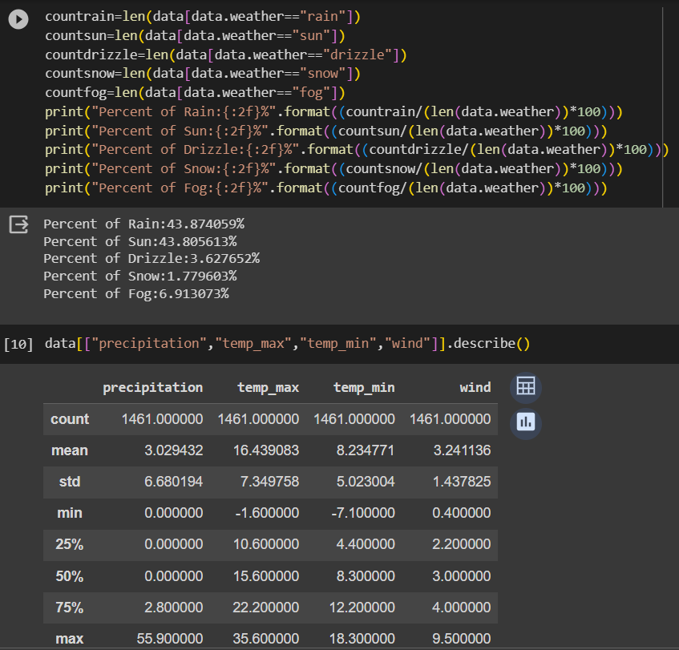
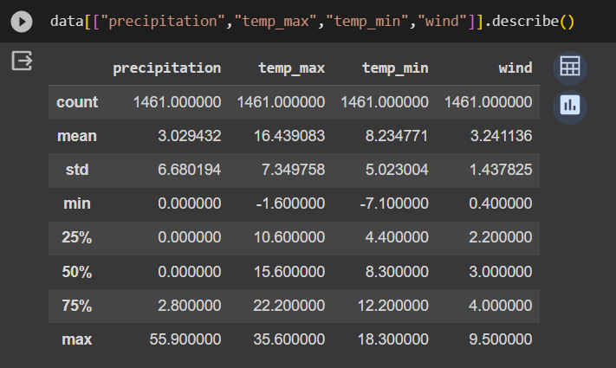
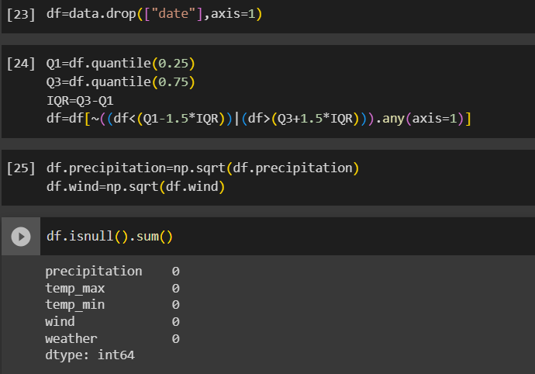

Slide 7
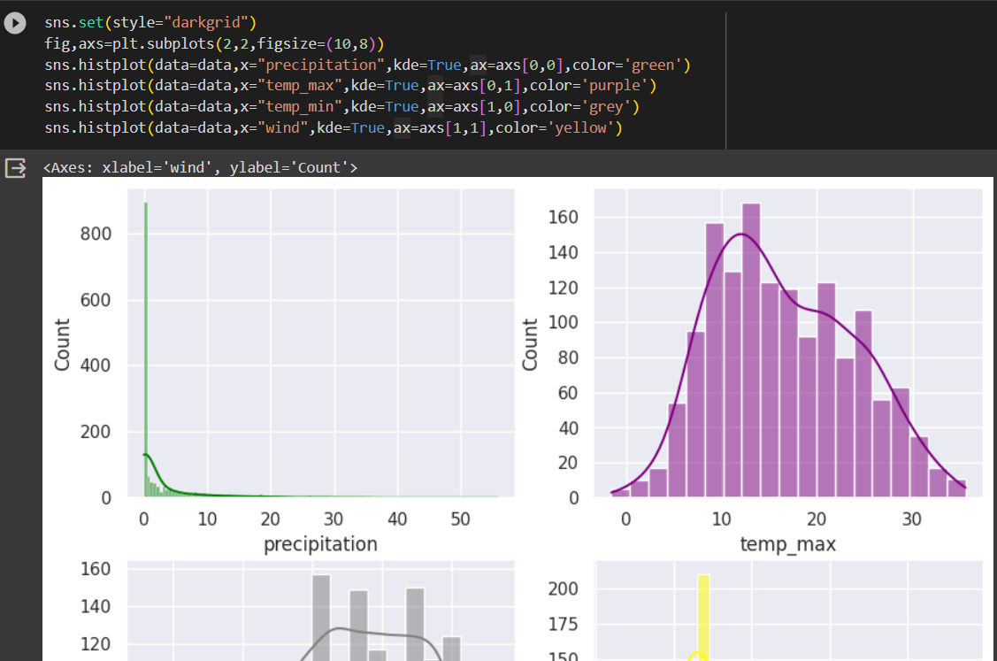
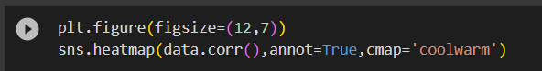
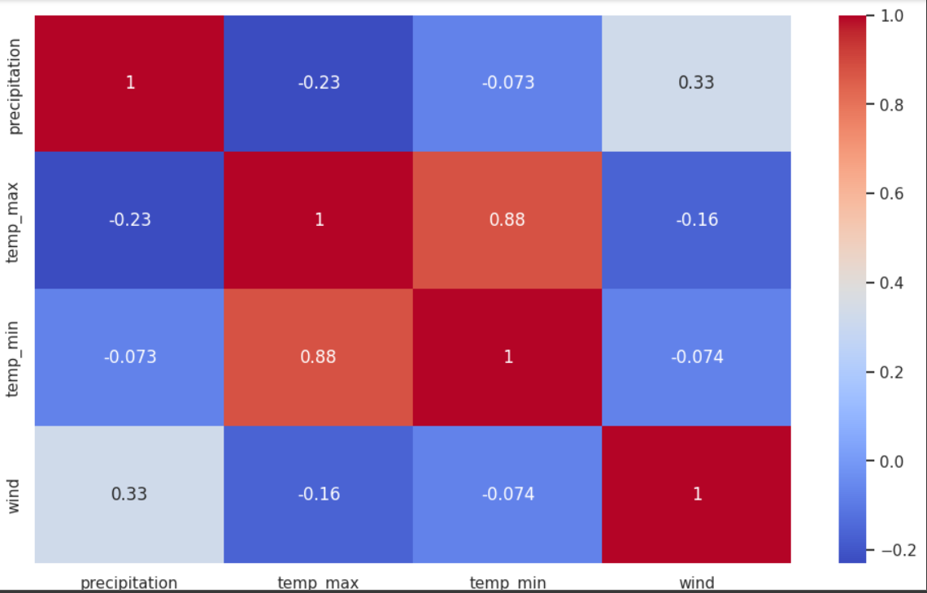
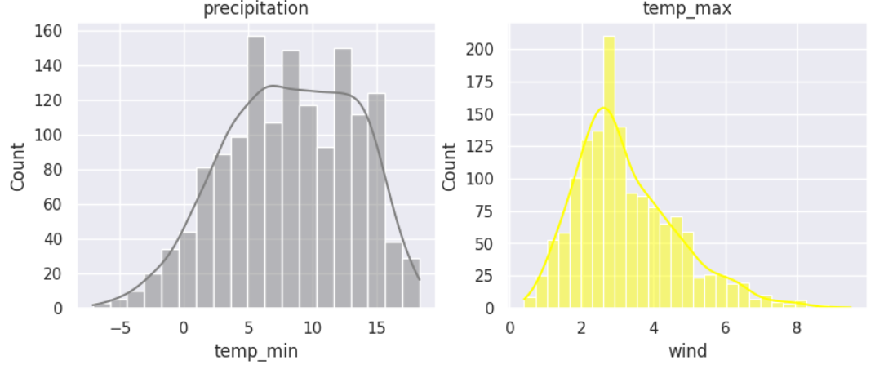

Slide 8
Data Description
https://mausam.imd.gov.in/

Slide 9
Attributes and Variables

